Slide 1
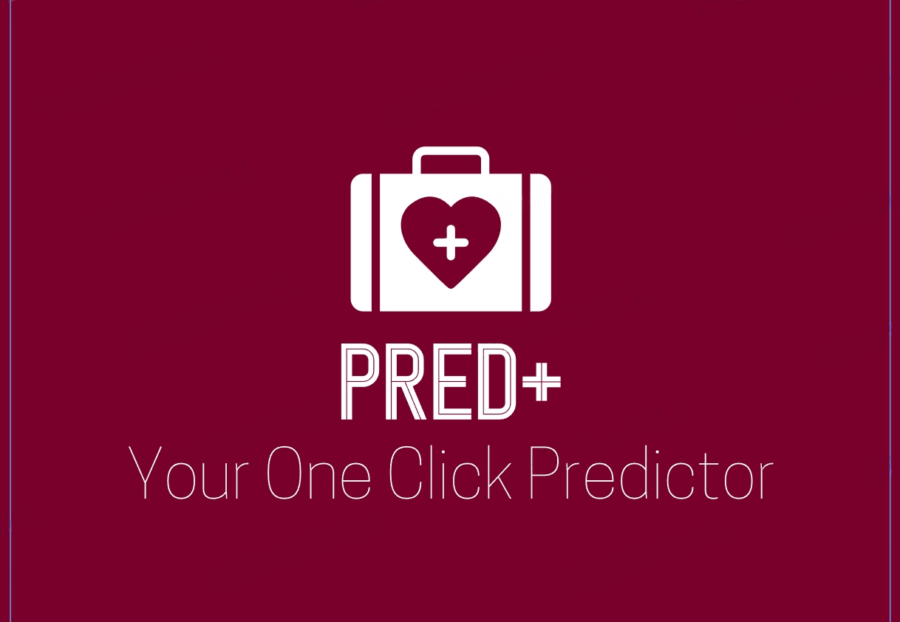
Team TECHNEEKS
Yash Kamble Darshit Baghtani Sanchit Patil Sridhar Sundar

Slide 2
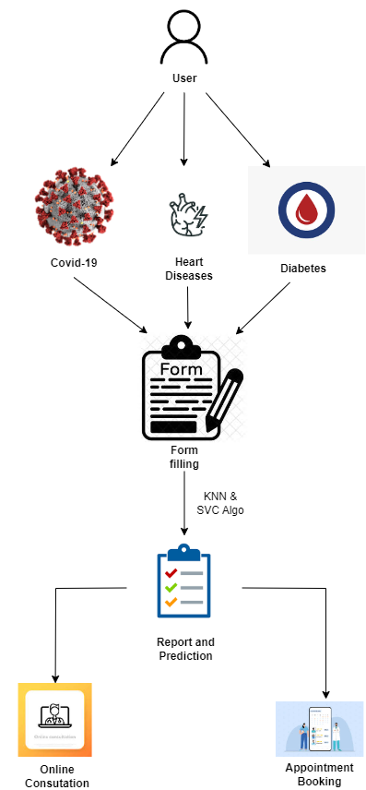

Architectural diagram

Slide 3
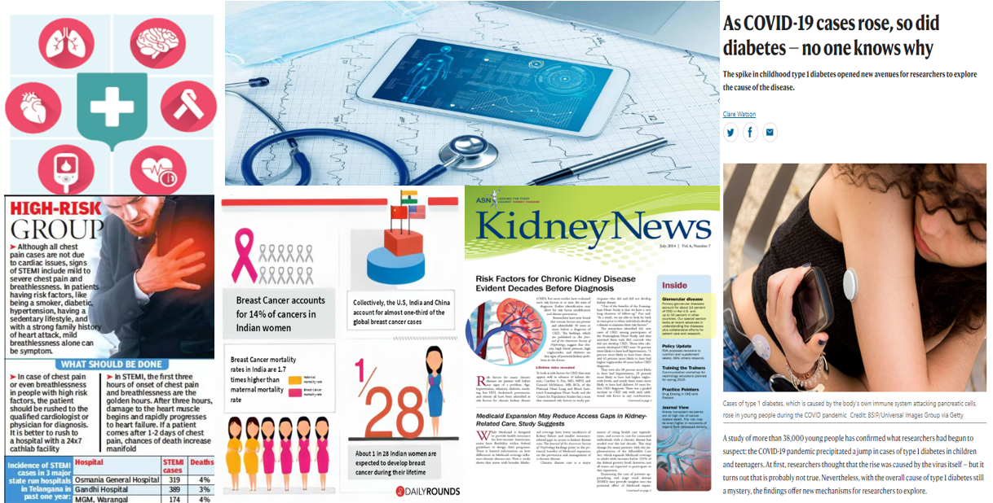
QUICK DISEASE PREDICTOR - PRED+
+

Slide 4
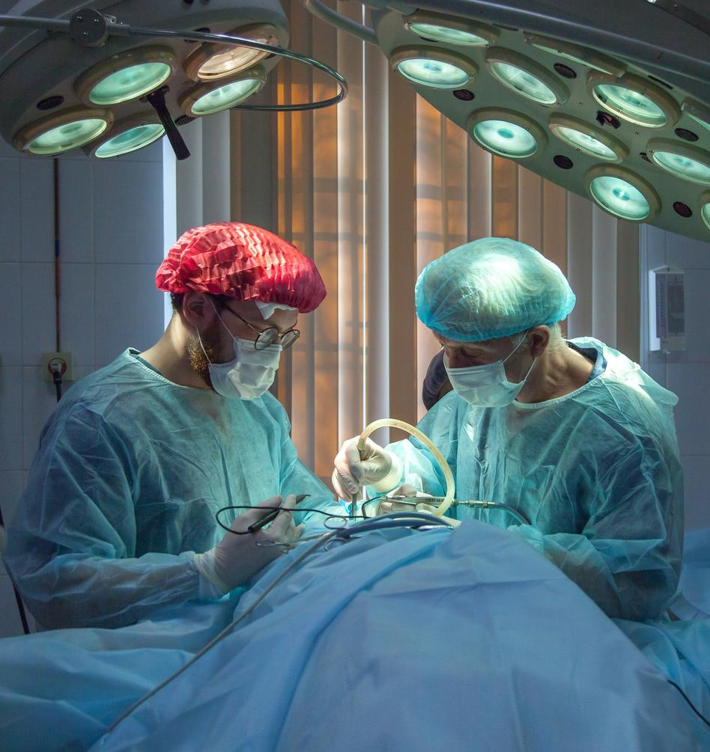
Future Scope
Malaria Prediction
We'll be implementing machine learning models such as
Linear Regression that can predict the likelihood of a user having cancer based on certain input data, such as medical history, symptoms, or test results.
These models will be trained on extensive datasets containing patient information, diagnosis outcomes, and other relevant factors.
Diabetes Prediction
Similar to our malaria prediction feature, we're planning to develop machine learning models to predict the risk of diabetes for users. This prediction will be based on factors such as age, family history, lifestyle choices, and physical health metrics like BMI, and glucose levels.
Also, we would be catering doctors to the website for online consulation and appointment booking.

Slide 5

Project Summary
We, Team Techneeks with our project - Pred+, aim to create a Machine learning model which will detect various diseases by entering symptoms and reports .
Advanced algorithms and predictive models will be implemented to analyze the user's personal health data, such as medical history,symptoms, reports. These models will generate personalized predictions on the probability of developing specific diseases.

Slide 6

Purpose of the Project
Many individuals face difficulties while finding accurate information regarding their developing diseases.
There is an significant gap for a user-friendly platform which can help a person for making decision about their health so that it can seek appropriate medical guidance.
To provide results in terms of probability to inform users about the severity(or chances) of users getting infected by the diseases.
To make a single platform/system to conduct tests for multiple diseases and help doctors in analyzing the huge datasets and provide them more insights about patient’s data so that they can make better decisions.
To conduct tests for the diseases in the simplest and cheapest way and predict any possibility of a disease on the basis of symptoms.

Slide 7
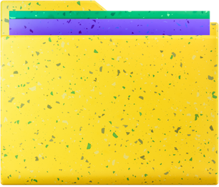
DATA SOURCES USED
Diabetes : https://www.kaggle.com/datasets/iammustafatz/diabetes-prediction-dataset
Covid : https://www.kaggle.com/datasets/martuza/early-stage-symptoms-of-covid19-patients
LIBRARIES USED:
ML ALGORITHMS USED:
DATA ANALYSIS USED :
Jupyter
Numpy
Pandas
Seaborn
Matplotlib
Scikit-Learn
Logistic Regression
K-Nearest Neighbours
Support Vector Classifier
WEB DEVELOPMENT TOOLS :
HTML, CSS, BOOTSTRAP
DJANGO, MySQLite

Slide 8
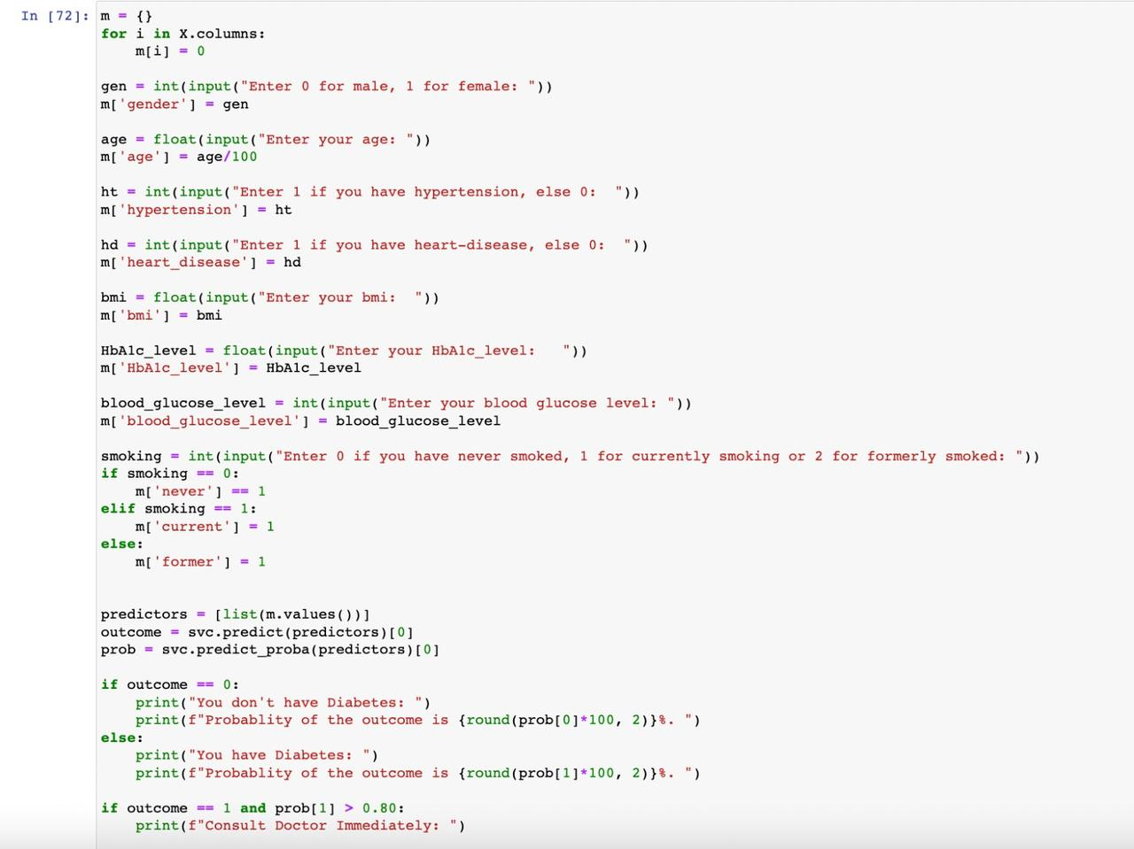
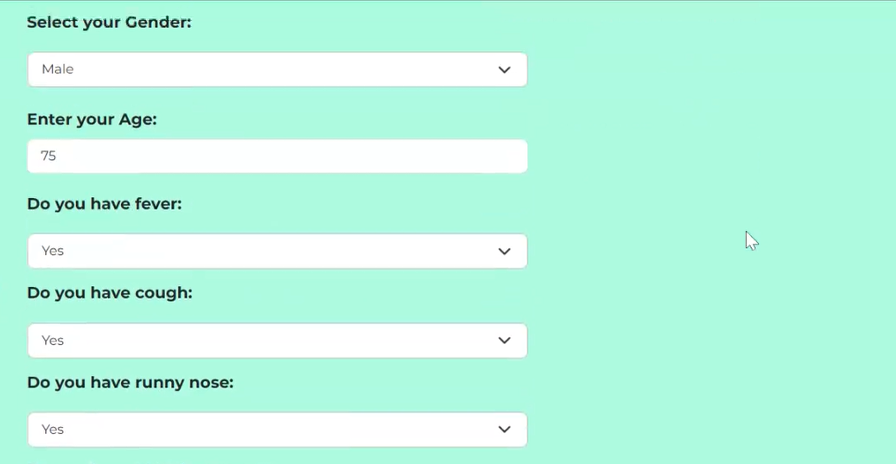
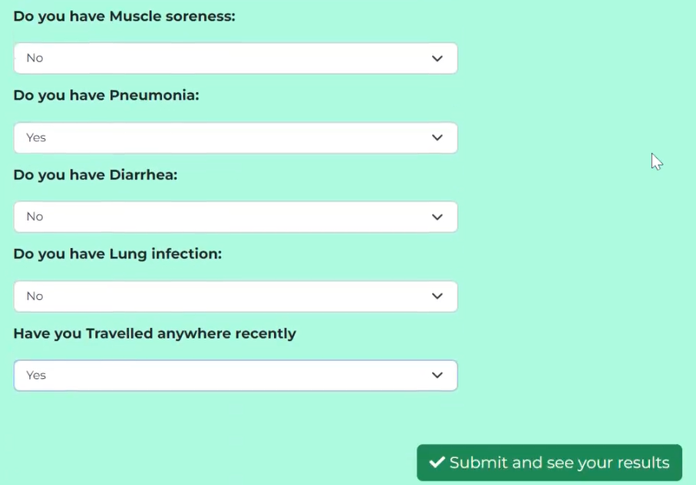
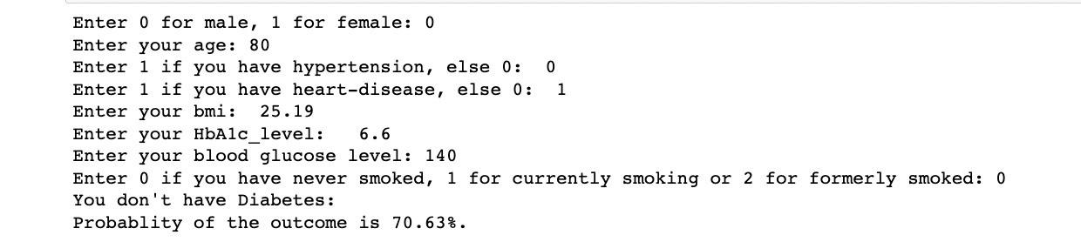
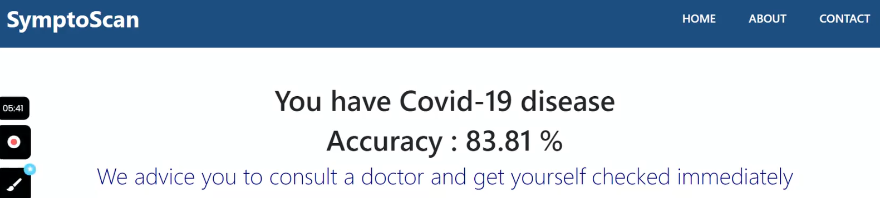
Results

Slide 9
Social Impact
Early Detection and Prevention: Pred+ help users detect diseases at an early stage when they might be more treatable or manageable. This can potentially save lives and reduce the severity of illnesses.
Healthcare Accessibility: It provides access to health information and predictions to people who may not have easy access to healthcare services, especially in remote or underserved areas.
Empowerment: Users can become more proactive about their health by regularly checking their risk factors and making lifestyle changes to reduce their disease probability.
Reduced Healthcare Costs: Early detection and prevention can reduce the overall healthcare costs by avoiding expensive treatments for advanced diseases.
Data Collection for Research: With user consent and privacy protections, the data collected through the website could contribute to valuable medical research and epidemiological studies.

Slide 10
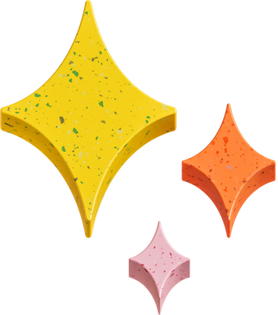
THANK YOU!

